Slide 1


E-Commerce: Security Challenges and Solutions
Dr. Khalid Al-Tawil
College of Computer Sciences & Engineering
King Fahd University of Petroleum and Minerals

Slide 2

Outline of the Presentation
Internet Security
Cryptography
Firewalls
E-Commerce Challenges
E-Commerce Security
Global & Local Issues

Slide 3
Challenges to Security
Internet was never designed with security in mind.
Many companies fail to take adequate measures to protect their internal systems from attacks.
Security precautions are expensive {firewalls, secure web servers, encryption mechanisms}.
Security is difficult to achieve.

Slide 4
Introduction
Two Major Developments During the Past Decade:
1. Widespread Computerization
2. Growing Networking and Internetworking
⬇ The Internet
Need for Automated Tools for Protecting Files and Other Information.
Network and Internetwork Security refer to measures needed to protect data during its transmission from one computer to another in a network or from one network to another in an internetwork.

Slide 5
…Continue
Network security is complex. Some reasons are:
Requirements for security services are:
  Confidentiality
  Authentication
  Integrity
Key Management is difficult.
Creation, Distribution, and Protection of Key information calls for the need for secure services, the same services that they are trying to provide.

Slide 6
Cyberterrorists
In 1996 the Pentagon revealed that in the previous year it had suffered some two hundred fifty thousand attempted intrusions into its computers by hackers on the Internet
Nearly a hundred sixty of the break-ins were successful.

Slide 7
…Continue
Security Attacks:
  Interruption
  Interceptor
  Modification
  Fabrication
  Viruses
Passive Attacks:
Interception(confidentiality)
  Release of message contents
  Traffic Analysis

Slide 8


…Continue
Active Attacks:
  Interruption (availability)
  Modification (integrity)
  Fabrication (integrity)

Slide 9
Security Threats
Unauthorized access
Loss of message confidentiality or integrity
User Identification
Access Control
Players:
  User community
  Network Administration
  Introducers/Haclers
The bigger the system, the safer it is
  MVS mainframe users (5%)
  UNIX users (25%)
  Desktop users (50%)

Slide 10

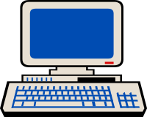

Introduction to Security Risks
Hackers and crackers
The Internet:
open
“$$”
Your network: data!
virus

Slide 11
The Main Security Risks
Data being stolen
  Electronic mail can be intercepted and read
  Customer’s credit card numbers may be read
Login/password and other access information stolen
Operating system shutdown
Filesystem corruption
User login information can be captured

Slide 12
Viruses
Unauthorized software being run
  Games
Widely distributed software
  Shareware
  Freeware
  Distributed software

Slide 13
Possible Security “Holes”
Passwords
  Transmitted in plain text
  Could be temporarily stored in unsafe files
  Could be easy to guess
Directory structure
  Access to system directories could be a threat
In the operating system software
  Some operating system software is not designed for secure operation
  Security system manager should subscribe to
    comp.security.unix
    comp.security.misc
    alt.security

Slide 14
Security Strategies
Use a separate host
  Permanently connected to the Internet, not to your network.
  Users dial in to a separate host and get onto the Internet through it.
Passwords
  Most important protection
  Should be at least eight characters long
  Use a mixture of alpha and numeric
  Should not be able to be found in dictionary
    should not be associated with you!
  Change regularly

Slide 15
…Continue
Every transaction generates record in a security log file
  Might slow traffic and host computer
  Keeps a permanent record on how your machine is accessed
Tracks
  Generates alarms when someone attempts to access secure area
  Separate the directories that anonymous users can access
  Enforce user account logon for internal users
  Read web server logs regularly

Slide 16
Cryptography
The Science of Secret writing.
Encryption: Data is transformed into unreadable form.
Decryption: Transforming the encrypted data
back into its original form.
Encryption
Plaintext
Ciphertext
Decryption
Types of Cipher
  Transposition
  Substitution

Slide 17
Types of Cryptosystems
Conventional Cryptosystems
  Secret key Cryptosystems.
  One secret key for Encryption and Decryption.
  Example: DES
Public key cryptosystems
  Two Keys for each user
    Public key (encryptions)
    Private key (decryptions)
  Example: RSA

Slide 18
Types of Cryptosystems
(Secret Key)
Both the encryption and decryption keys are kept secret.
  Example:
  To encrypt, map each letter into the third letter forward in the alphabet order;
  To decrypt, map each letter into the third letter back.
Problems with Secret Key Cryptosystems:
  Key transfer
  Too many keys

Slide 19
Secret Key Cryptosystems
(DES)
Data Encryption Standard (1977)
Started with an IBM Project called LUCIFER (1971)
DES key length: 56-bits
Uses 16 iterations with
  Transportation
  Substitution
  XOR operations
DES Criticism
  Key length
  Design of S-Boxes in hidden
Future
  Multiple DES
  IDEA ( International Data Encryption Algorithm)

Slide 20
Types of Cryptosystems
(Public Key)
Only the decryption key is kept secret. The encryption key is made public.
Each user has two keys, one secret and one public.
Public keys are maintained in a public directory.
To send a message M to user B, encrypt using the public key of B.
B decrypts using his secret key.
Signing Messages
For a user Y to send a signed message M to user X.
  Y encrypts M using his secret key.
  X decrypts the message using Y’s public key.

Slide 21
Public Key
A
M
encryption
C
B
Public key of B
Private Key of B
Ciphertext C
C
decryption
M
Insecure communications or
storage.
Territory of the Intruder
A wants to send M in a secure manner to B

Slide 22
Firewalls
A firewall is a barrier placed between the private network and the outside world.
All incoming and outgoing traffic must pass through it.
Can be used to separate address domains.
Control network traffic.
Cost: ranges from no-cost (available on the Internet) to $ 100,000 hardware/software system.
Types:
  Router-Based
  Host Based
  Circuit Gateways

Slide 23
Firewall
Filter
Filter
Inside
Gateway(s)
Outside
Schematic of a firewall

Slide 24
Firewall Types
(Router-Based)
Use programmable routers
Control traffic based on IP addresses or port information.
Examples:
  Bastion Configuration
  Diode Configuration
To improve security:
Never allow in-band programming via Telnet to a firewall router.
Firewall routers should never advertise their presence to outside users.

Slide 25
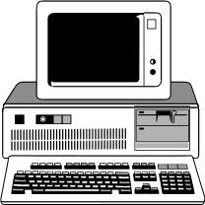
Bastion Firewalls
External
Router
Secured
Router
Host PC
Internet
Private Internal Network

Slide 26
Firewall Types
(Host-Based)
Use a computer instead of router.
More flexible (ability to log all activities)
Works at application level
Use specialized software applications and service proxies.
Need specialized programs, only important services will be supported.

Slide 27
…Continue
Example: Proxies and Host-Based Firewalls
Proxies and
Host-Based Firewalls
Host running only proxy versions of FTP,Telnet and so on.
Internal
Network
Filtering
Router
(Optimal)
Internet

Slide 28
Electronic Mail Security
E-mail is the most widely used application in the Internet.
Who wants to read your mail ?
  Business competitors
  Reporters,Criminals
  Friends and Family
Two approaches are used:
  PGP: Pretty Good Privacy
  PEM: Privacy-Enhanced Mail

Slide 29
E-mail Security
(PGP)
Available free worldwide in versions running on:
  DOS/Windows
  Unix
  Macintosh
Based on:
  RSA
  IDEA
  MD5

Slide 30
…Continue
Where to get PGP
  Free from FTP site on the Internet
  Licensed version from ViaCrypt in USA
Example:
pgp -kg ID-A Signature
pgp esa m.txt ID-B Encryption
pgp message Decryption

Slide 31
E-mail Security
(PEM)
A draft Internet Standard (1993).
Used with SMTP.
Implemented at application layer.
Provides:
  Disclosure protection
  Originator authenticity
  Message integrity

Slide 32
Summary of PGP Services
Function Algorithms used Description
Message IDEA, RSA A message is encrypted
encryption using IDEA . The session key is encrypted using RSA
recipient’s public key.
Digital RSA, MD5 A hash code of a message
signature is created using MD5. This
is encrypted using RSA with the sender’s private key.
Compression ZIP A message may be compressed using ZIP.
E-mail Radix 64 conversion To provide transparency
compatibility for e-mail applications.

Slide 33
Summary of PEM Services
Function Algorithms used Description
Message DES A message is encrypted using
encryption DES-CBC. The session key
is encrypted using RSA with the recipient’s public key.
Authentication RSA with A hash code of a message
and Digital sig- MD2 or MD5 is created using MD2 or MD5.
nature(asymmetric This is encrypted using RSA
encryption) with the sender’s private key.
E-mail Radix 64 conversion To provide transparency for
compatibility e-mail applications.

Slide 34
E-Commerce: Challenges
Trusting others electronically
  E-Commerce infrastructure
Security threats – the real threats and the perceptions
Network connectivity and availability issues
  Better architecture and planning
Global economy issues
  Flexible solutions

Slide 35
E-Commerce: Challenges
Trusting others electronically
  Authentication
  Handling of private information
  Message integrity
  Digital signatures and non-repudiation
  Access to timely information

Slide 36
E-Commerce: Challenges
Trusting Others
Trusting the medium
  Am I connected to the correct web site?
  Is the right person using the other computer?
  Did the appropriate party send the last email?
  Did the last message get there in time, correctly?

Slide 37
E-Commerce: Solutions
Trusting Others
Public-Key Infrastructure (PKI)
  Distribute key pairs to all interested entities
  Certify public keys in a “trusted” fashion
    The Certificate Authority
  Secure protocols between entities
  Digital Signatures, trusted records and non-repudiation

Slide 38
E-Commerce: Challenges
Security Threats
Authentication problems
  Impersonation attacks
Privacy problems
  Hacking and similar attacks
Integrity problems
Repudiation problems

Slide 39
Secure Protocols
How to communicate securely:
  SSL – “the web security protocols”
  IPSEC – “the IP layer security protocol”
  SMIME – “the email security protocol”
  SET – “credit card transaction security protocol”
  Others …

Slide 40
Secure Sockets Layer (SSL)
Platform and Application Independent
  Operates between application and transport layers
Web Applications
HTTP
NNTP
FTP
Telnet
Etc.
Future
Apps
SSL
TCP/IP
Notes:
Idea being SSL can support common security services between existing and future apps with little application modification and no need to alter the operating system.

Slide 41
Secure Sockets Layer (SSL)
Negotiates and employs essential functions for secure transactions
  Mutual Authentication
  Data Encryption
  Data Integrity
As simple and transparent as possible
Notes:
Value of Simple = easy to understand its security(in traditional internet ways -- more complex == harder to make sure its secure)
Transparent to affect applications in the most inexpensive ways possible
Provides lowest common denominator but essential security services that form the foundation for other, more specific application security

Slide 42
SSL 3.0 Layers
Record Layer
  Fragmentation, Compression, Message Authentication (MAC), Encryption
Alert Layer
  close errors, message sequence errors, bad MACs, certificate errors
Notes:
Fragmentation: Allows large certificates and other messages to be handled without error
Compression: Creates space for optimization
MACs: Primary Data Integrity Function
Encryption: Using negotiated cipher (cipherspec) and session key (master secret)

Slide 43
Why did SSL Succeed
Simple solution with many applications – e-business and e-commerce
No change in operating systems or network stacks – very low overhead for deployment
Focuses on the weak link – the open wire, not trying to do everything to everyone
Solution to authentication, privacy and integrity problems and avoiding classes of attacks

Slide 44
SSL and Security Attacks – or how to design secure protocols
Man in the middle
Spoofing attacks
Replay attacks and transaction freshness
Negotiation attacks
Snooping attacks

Slide 45
S-HTTP
Secured HTTP (S-HTTP)
  Security on application layer
  Protection mechanism:
    Digital Signature
    Message authentication
    Message encryption
  Support private & public key cryptograph
  Enhanced HTTP data exchange

Slide 46
S-HTTP vs. SSL
 | User Interface
Application Layer | S-HTTP | HTTP, SMTP, FTP, Telnet, Other Apps.
 | SSL | PCT | SET
Transport Layer | Transport Control Protocol
Internet Layer | Internet Protocol (IP)
Network Layer | Network

Slide 47

SSL
Operate on transport layer
Encryption only for integrity and confidentiality
Support HTTP, Telnet, FTP, Gopher, etc.
Application independent
Provide P-to-P protection
DES, RSA, RC-2 and RC-4 with different size of keys
One step security
S-HTTP
Operate on application layer
Encryption and digital signature
Work only with (HTTP)
Application dependant
More secure than SSL at end point even after data transfer
No particular cryptographic system
Multiple times encryption

Slide 48
Secured Electronic Transactions (SET)
Developed by VISA & MasterCard
SET Specifications:
  Digital Certificates (Identification)
  Public Key (Privacy)
On-Line Shopping Steps:
  C.H. Obtain Digital Wallets
  C.H. Obtain Digital Certificates
  C.H. & Merchants conduct Shopping Dialog
  Authentication & Settlement Process

Slide 49
E-Commerce: Challenges
Connectivity and availability
Issues with variable response during peak time
Guaranteed delivery, response and receipts
Spoofing attacks
  Attract users to other sites
Denial of service attacks
  Prevent users from accessing the site
Tracking and monitoring networks

Slide 50
E-Commerce: Challenges
Global Economy
Variable connectivity levels and cost
Variable economies and cultures
Taxation and intellectual property issues
Interoperability between different economies

Slide 51
Existing Technologies Overview
Networking Products
Firewalls
Remote access and Virtual Private Networks (VPNs)
Encryption technologies
Public Key Infrastructure
Scanners, monitors and filters
Web products and applications

Slide 52
Remote access and VPNs
Better control for user access
VPNs connect offices together using the public network, with authenticated encrypted channels
IPSEC as a basic security protocol for remote access and VPN products

Slide 53
Encryption Technologies
Hardware assist to speed up performance
Encryption at different network layers; Layer2 through application layers
Provide both public-key systems as well as bulk encryption using symmetric-key methods
Stored data encryption and recovery

Slide 54
PKI
A set of technologies and procedures to enable electronic authentication
Uses public key cryptography and digital certificates
Certificate life-cycle management

Slide 55
PKI -- the myths
PKI solves all e-commerce problems
PKI is very easy to deploy and use
PKI is totally unusable and unscalable

Slide 56
PKI -- the reality
Many products from many vendors are available for certificate issuance and some management functions
Interoperability is a big issue -- especially when it comes to policies
Enabling the use of PKI in applications is limited today
Building and managing policies is the least understood issue

Slide 57
Policies
Authentication and registration of certificate applicants
System administration and access to signing keys
Key “Escrow” accessibility
Application use and interfacing
Trust between hierarchies

Slide 58
…Continue
Trust decisions to be made at different points within the application need different views
Certificate fields, authorization and allowed use is really the hardest issue
Authorization policies for management of CAs and RAs

Slide 59
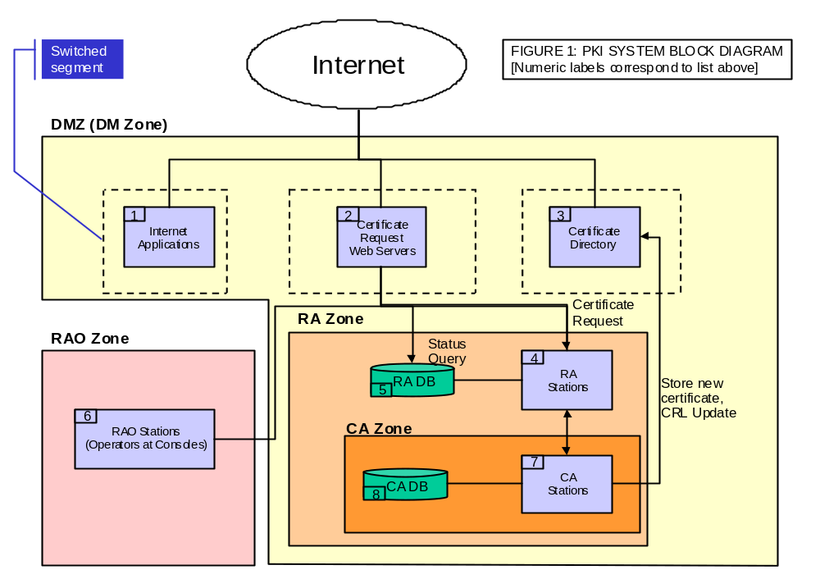
PKI Architecture

Slide 60
Scanners, Monitors and Filters
Too much network traffic without designed policies
Scanners understand the network configurations
Monitors provide intrusion detection based on preset patterns
Filters prevent unwanted traffic – based of “type”, for example virus detection

Slide 61
Web Products
Secure web servers – SSL enabled
Application servers – generally lacking any security support
A number of toolkits to enable applications to utilize security functions
Integration into existing (legacy) infrastructure is difficult

Slide 62
What is Missing??
Solid architecture practices
Policy-based proactive security management
Quantitative risk management measures especially regarding e-commerce or e-business implementations

Slide 63
E-Commerce Architecture
Support for peak access
Replication and mirroring, round robin schemes – avoid denial of service
Security of web pages through certificates and network architecture to avoid spoofing attacks

Slide 64
Proactive Security Design
Decide on what is permissible and what is right
Design a central policy, and enforce it everywhere
Enforce user identities and the use of credentials to access resources
Monitor the network to evaluate the results

Slide 65
PKI and E-Commerce
Identity-based certificate to identify all users of an application
Determine rightful users for resources
“Role-based” certificates to identify the authorization rights for a user

Slide 66
Architectures for E-Commerce
Central Policy Node
Perimeter
A
P
P
L
I
C
A
T
I
O
N
PKI based policy decisions
To other networks
PKI based user access
Enforcement
Nodes

Slide 67
Existing EPS:
Electronic Cash
  Imitates Paper Cash
  Examples: CyberCash, CyberCoin, DigiCash and Virtual Smart Cards
Electronic Checking
  Same as Paper Checks
  Use Automated Clearing House (ACH)
  Examples: CheckFree, NetCheque and NetChex
  Not well developed as E-Cash or Credit Card
Credit Cards
  Not used in Internet until SET become Internet Standard

Slide 68
E-Commerce: Are We Ready?
Infrastructure?
Security?
Policies & legal issues?
Arabic content?

Slide 69
E-Commerce: Future
Was expected to reach 37,500 (million US $) in 2002. It reached 50,000 (million US $) in 1998
Expected to reach 8 million company in 2000. (40% of total commerce)
Arab word, about 100 million US $

Slide 70
…Continue
B-to-B E-Commerce will grow faster than B-to-C E-Commerce
E-business is expected to grow faster in: Europe 118% Annual growth rate
worldwide 86% *
Number of companies is expected to reach 8 million by 2002 **
* Study by Nortel Networks (Financial Times 28/1/2000)
** British Telecom

